Slide 1
Introducing Numeracy into the Early Years
Presenter: Di Liddell
Date: 9th June 2022

Slide 2
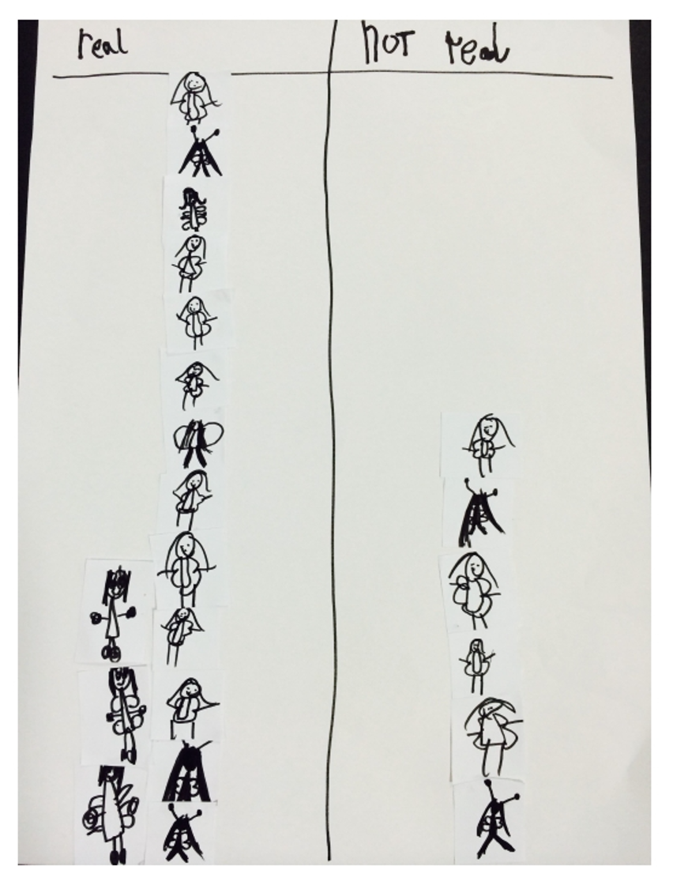
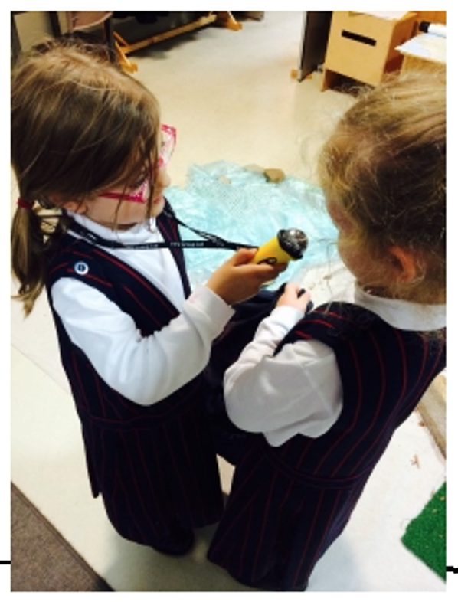
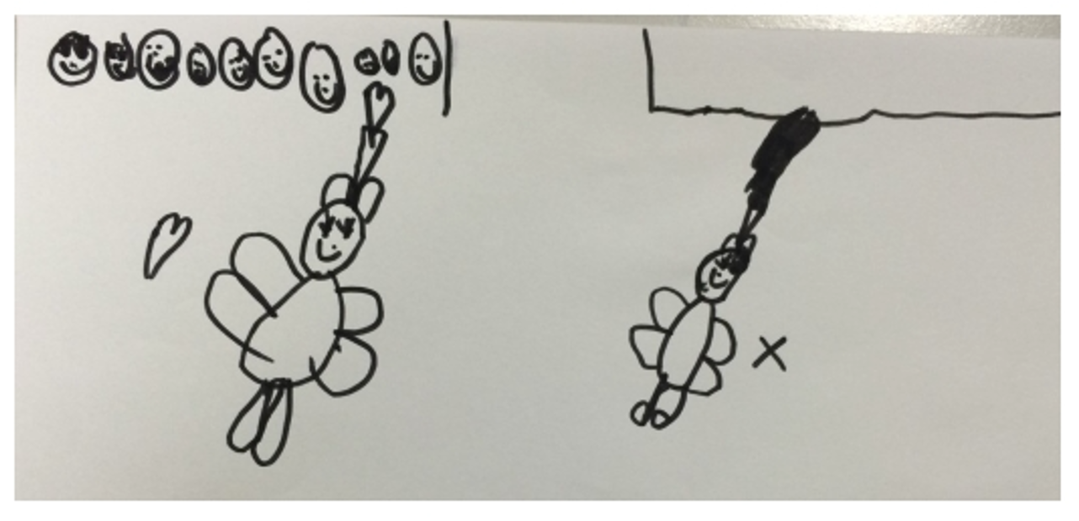
Introducing Numeracy into the Early Years (Kinder - Grade 2)
www.3es.org

Slide 3
Dianne Liddell
Over fifteen years experience across State, Catholic and Independent schools both nationally and internationally.
Education Consultant with MAV
Mathematics Tutor at Swinburne University
Expertise in leading play based and inquiry teaching approaches into Early Years.
Completing Master of Educational Research at Melbourne University
Notes:
1. I have been working in the education sector for over fifteen years and have experience across State, Catholic and Independent schools both nationally and internationally in the UK and USA.
2. Education consultant for the Mathematics Association of Victoria. My role involves working with schools on various ongoing professional development requirements. I have recently completed managing an new exciting initiative from the Victorian Department of Education and Training, called the Middle Years Maths Challenge. Where the project aims to support student engagement in mathematics across Levels 5–9 by designing a series of highly engaging mathematics challenges with topics that students identified. These lessons have recently been published online - https://fuse.education.vic.gov.au/Pages/mymc I am now managing another project with the DET, focused on the creation of learning sequences for F- 4. These are currently being written and hoped to be published by the end of the year.
3. I am a Mathematics Tutor at Swinburne University, where I work with preservice teachers to help gain an understanding of the implementation of contemporary mathematics pedagogies in the Early Years.
4. My experience focuses on the implementation of play based/ inquiry teaching approaches into Early Years learning environments. As a mentor and coach I have led the successful transformation of teaching pedagogies that have increased student (and teacher) engagement through active participation.
5. It is from this experience as an Early Years Leader and a strong supporter of the Reggio Emilia approach, that has lead to me being offered a scholarship through Melbourne University to explore the pedagogical practices that are employed in the classroom to illuminate and honour the voice of the child. So what does this actually mean? I am identifying specific pedagogical practices that we as teachers use to empower and engage children to participate in their learning. By honouring student voice we empower children to take ownership of their learning.
I am an advocate for the reconceptualisation of education, to one that is child centered and facilitated through a pedagogy of listening.
This is all well and good, but how am I going to do this? Well it starts with you!

Slide 4
Notes:
From my diverse experience internationally, at low socio economic schools, to the elite independent schools what have i learnt the most? Pedagogy matters.
Yes we need to teach children to read, write, count but how we do that can be so very different and ultimately it's up to us, what this looks like.

Slide 5
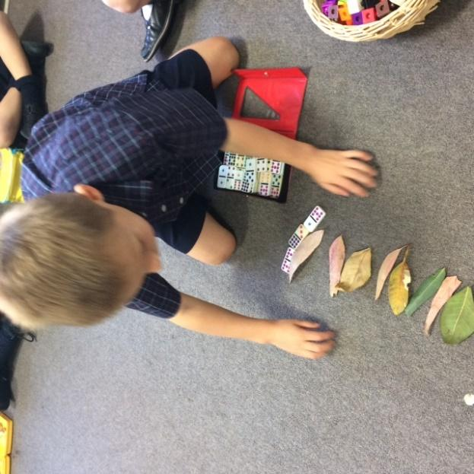
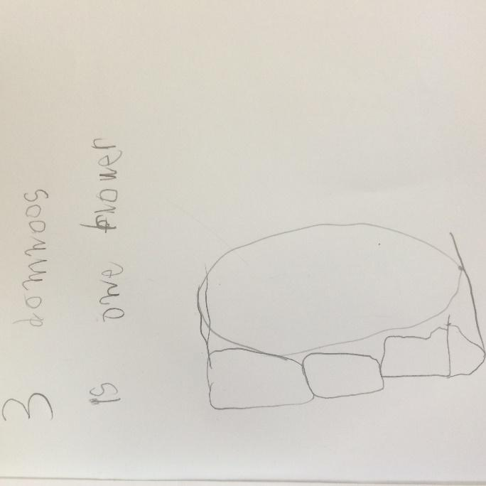
How I ended up here...
Notes:
To begin I need to share story of how I ended up where I am today.
It all began with the Junior school head of the school at the time, asking me to take prep the following year…
Initial thoughts - babysit children, not interested in playing … my experience and knowledge is in the upper primary years, grade ⅚ that what I like, that's what i’m good at…
Negotiations ...and lots of positive persuasion from the head… I accepted the position…
My first few days, months, probably semester was filled with lots of “oh my goodness moments!” they can’t sit, they don’t put up their hands, they can’t even open their lunch boxes! It's fair to say it was definitely a learning curve for me!
As the term progressed and I began to adapt my pedagogy to suit the needs of the children, my days became easier and I began to see teaching like I had never seen it before.
It was no longer about me, being the know it all, imparting information they needed to absorb, but instead these children knew a lot!
They saw the world as it was, and were filled with the curiosity and desire to find out why.
My final takeaways from that first year in prep year can be summed up my the following words, profound, playful and ENGAGING!
I learnt that learning can be observed in prep, literally every single day and it is through the interactions and experiences that we provide for our students that encourages them to become in engaged and active learners.
This learning has lead me to the path I am on today.

Slide 6
Reflecting on our image of a child
What is your image of the child?
How does our image of the child impact our practice?
Notes:
Before we can progress any further we need to understand our own pre-dispositions/ ideologies in relation to our students and that begins by reflecting on our image of the child.
Work collaboratively in groups to record
What is your image of the child?
If collectively our image of a child is one that is….
curious, capable, powerful, rich in potential
How does our image of the child reflect our practice?
Participants share thinking

Slide 7
Reflecting on our image of the teacher
What is your image of the teacher?
Notes:
With this in mind I would like to know ask you reflect on your image of the teacher?
If our image of the child is one that is capable, curious and competent how does this impact how we see ourselves as teachers?
How do you see as our role as teachers?

Slide 8
Plan for today
Documentation from a mathematical inquiry
The creation of play based learning spaces
Explorative pedagogical approach to learning
Notes:
Documentation from a mathematical inquiry will be shared and discussed giving you insight into how to plan, implement and assess mathematical inquiries in accordance with the Australian Curriculum and Early Years Learning Framework.
The concept of using the environment as a third educator will be discussed, in relation to the creation of play based learning spaces. Some examples of play spaces that are stimulating and inviting will be shared and ways that mathematically rich learning opportunities have been incorporated into the learning spaces will be explained.
And finally how we as educators can adopt these strategies through an Explorative pedagogical approach to learning through the implementation of a student choice board.

Slide 9
Number Detectives
Where do we see numbers?”
Notes:
investigation that took place during the first 4 weeks of school in a Foundation class.
created into a lesson that is available as a resource through Maths 300.
The lesson began with all the children sitting in a circle as I posed the question “Where do we see numbers?”
The use of an open-ended question here, provides all children with the opportunity to access their prior knowledge and recall examples of places they have seen numbers.

Slide 10
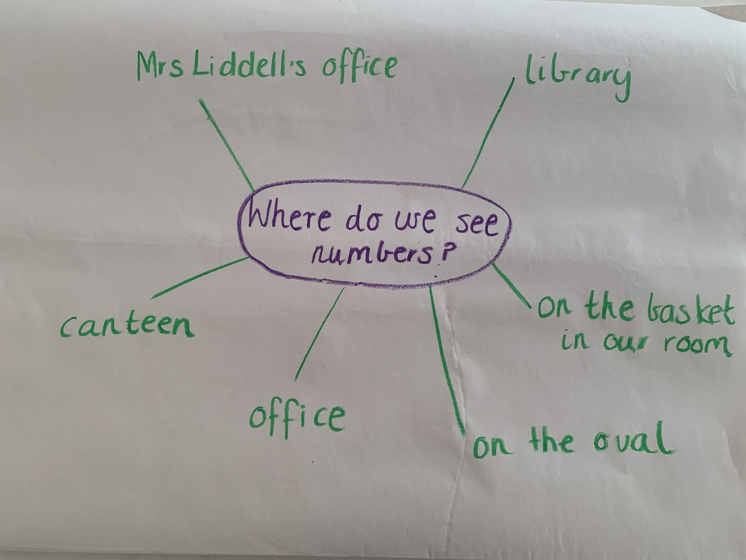
Brainstorm
Notes:
As a class, a brainstorm was created detailing all the possible places that the children had seen numbers.

Slide 11
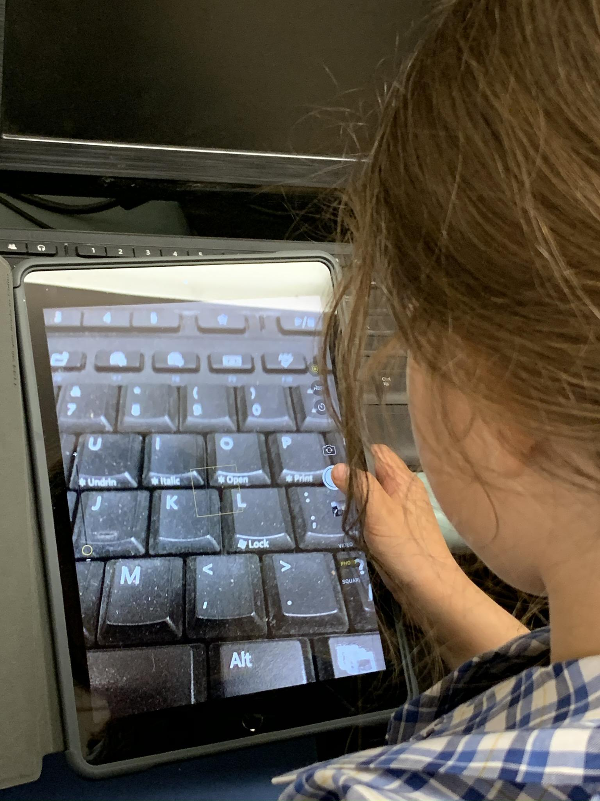
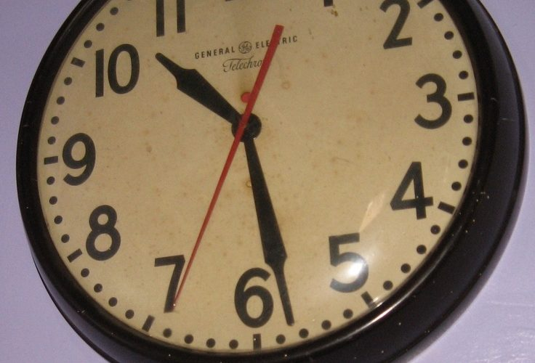
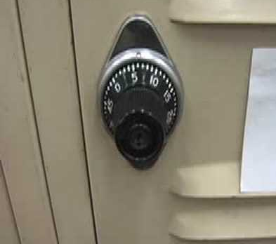
Number Hunt
Notes:
Armed with a selection of resources to assist them in recording their findings, eg. mini whiteboards/ markers, paper/ pencils, ipads /digital cameras.
the children became number detectives, with a mission of identifying and recording all the numbers around the school.
Working in small groups, the children visited each area of the school, the library, school canteen, office.. etc and explored all the numbers they can find in that space.

Slide 12
Group Reflection
What did they notice about the places they found numbers?
Were they surprised by their findings?
What is the purpose of the number?
Notes:
Group Reflection
We then brought the children back together to form a group reflection.
Ask the children as a group to discuss their findings, what did they notice about the places they found numbers? were they surprised by their findings?
Working in pairs, we encouraged the children to choose one photo/ drawing to explore further by thinking about, “what is the purpose of the number?” Eg. telephone pad. We encourage the children to think about the purpose of the numbers on the telephone pad and how they are used to connect to other phone lines.

Slide 13
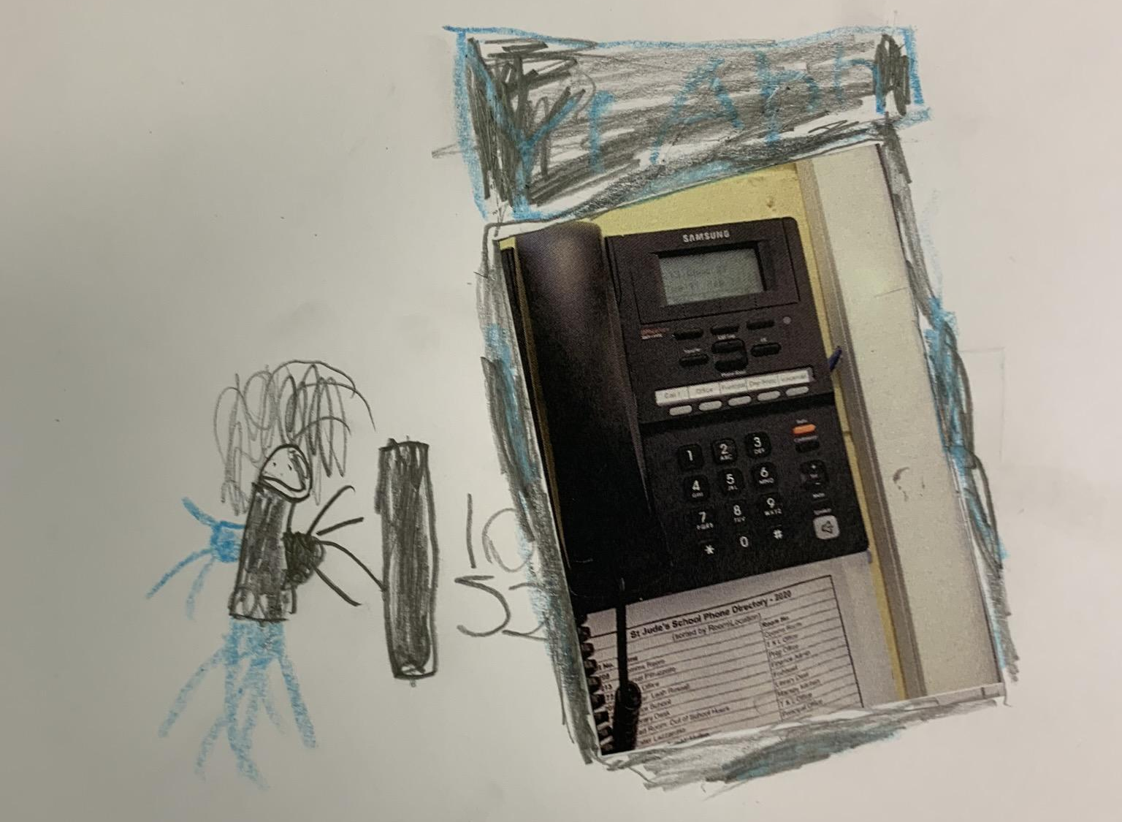
Task
Using the photo/ drawing, the children created a visual representation of the number in its natural environment.
Notes:
Task
Using the photo/ drawing, the children created a visual representation of the number in its natural environment.
An emphasis was placed on explaining to the children how as number detectives they will need to show evidence of where the number was found, and provide a justification for its purpose in that environment.
Two benefits were achieved by adding this dimension to the project.
Firstly by highlighting the purpose of the number in it’s natural environment, we are strengthening their understanding of numeracy and how numbers are not only used but necessary in our everyday environments.
Secondly this inclusion, offers children the opportunity to develop their mathematical reasoning as they need to justify the relevance and purpose of the numbers identified.

Slide 14
Group Reflection
Children were encouraged to share their findings with the remainder of the class, emphasising the purpose and relevance of the number in its environment.
Number Detectives
Notes:
And finally the Children were encouraged to share their findings with the remainder of the class, emphasising the purpose and relevance of their number in its environment.
Number Detectives

Slide 15
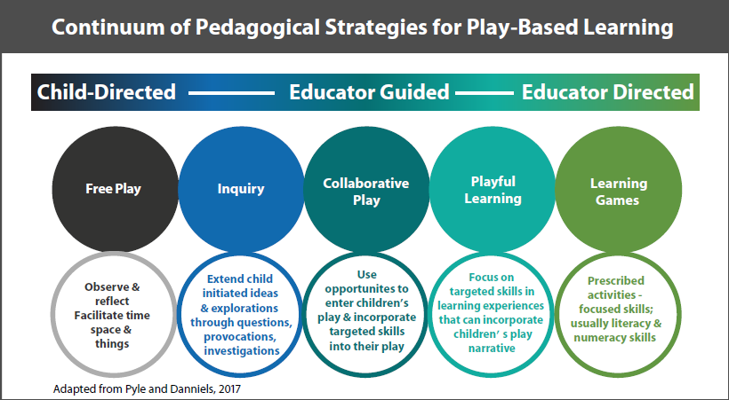
Key takeaways
Simple
Notes:
Simple, it’s not an investigation that needs to go on for hours and days, but a short simple introduction to recognising numerals in a way that is complementing the child’s prior knowledge of numeracy.
Can you see how the investigation includes elements of teacher directed learning, through the provocation of where do we see numbers? but then also student directed numbers, through the brianstorm of places to explore and then the recording of numbers itself.

Slide 16
The creation of play based learning spaces
Play is one of the most important ways in which young children gain essential knowledge and skills.
United Nations Children’s Fund (UNICEF). (2018). Learning through play. Retrieved from https://www.unicef.org/sites/default/files/2018-12/UNICEF-Lego-Foundation-Learning-through-Play.pdf
Notes:
Part 2: The creation of play based learning spaces
‘Play is one of the most important ways in which young children gain essential knowledge and skills’
This is not new to use as Early Childhood educators, we know this.
But identifying and planning for maths based experiences through play can be difficult at first, because often the learning is difficult to see to the untrained eye.

Slide 17
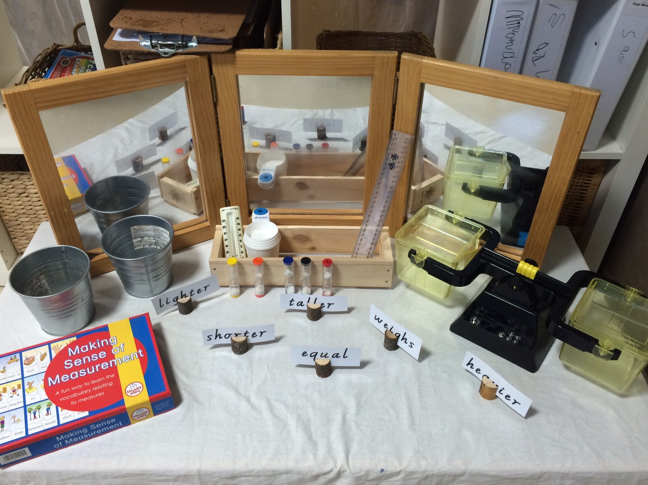
Exploring play spaces
What mathematical concepts could be explored here?
What learning outcomes could be addressed through this explorative play experience?
measurement, weight, mass, height, length, capacity,
Use direct and indirect comparisons to decide which is longer, heavier or holds more, and explain reasoning in everyday language (ACMMG006)
Notes:
Let’s start by exploring some examples of play spaces and discover;
What mathematical concepts could be explored here?
What learning outcomes could be addressed through this explorative play experience?
measurement, weight, mass, height, length, capacity,
Use direct and indirect comparisons to decide which is longer, heavier or holds more, and explain reasoning in everyday language (ACMMG006)

Slide 18
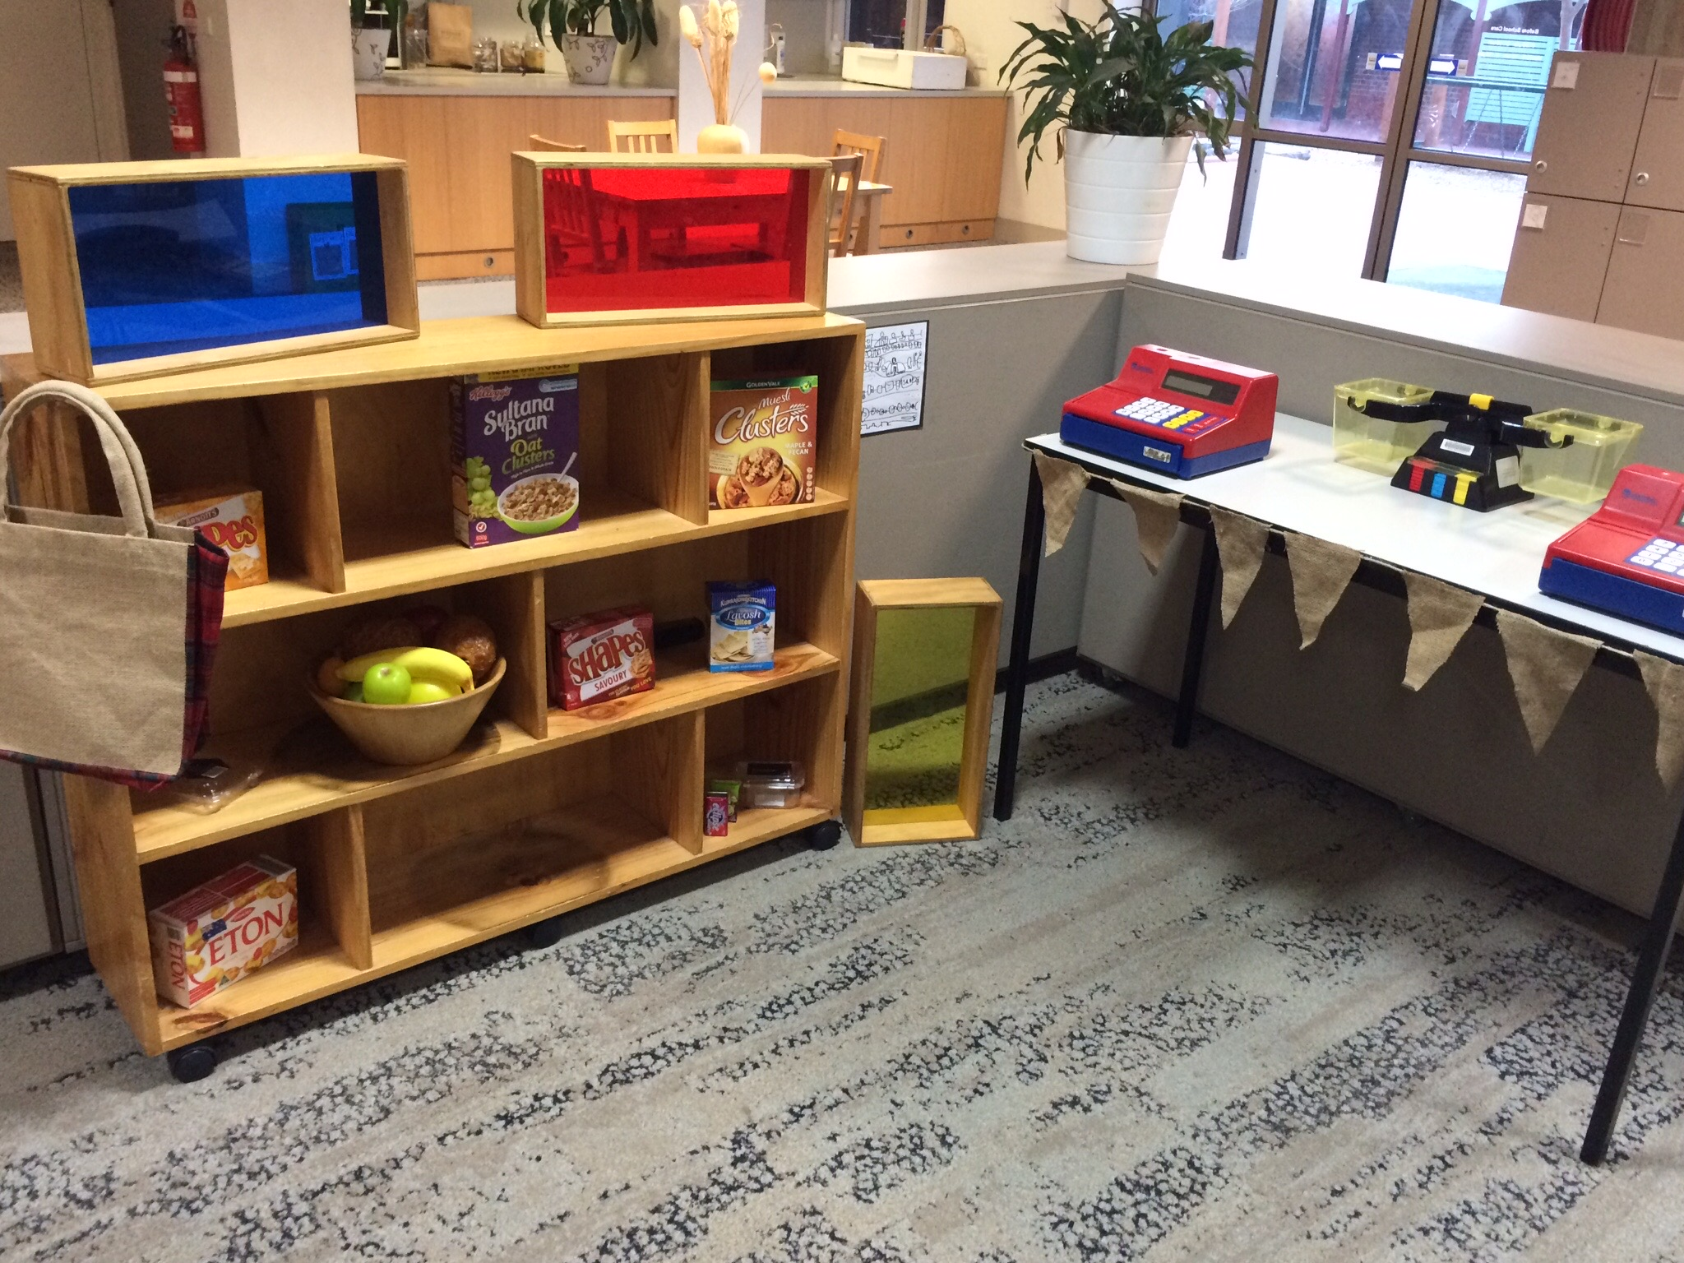
Exploring play spaces
What mathematical concepts could be explored here?
What learning outcomes could be addressed through this explorative play experience?
numeral recognition, number quantities, number names
Connect number names, numerals and quantities, including zero, initially up to 10 and then beyond (ACMNA002)

Slide 19
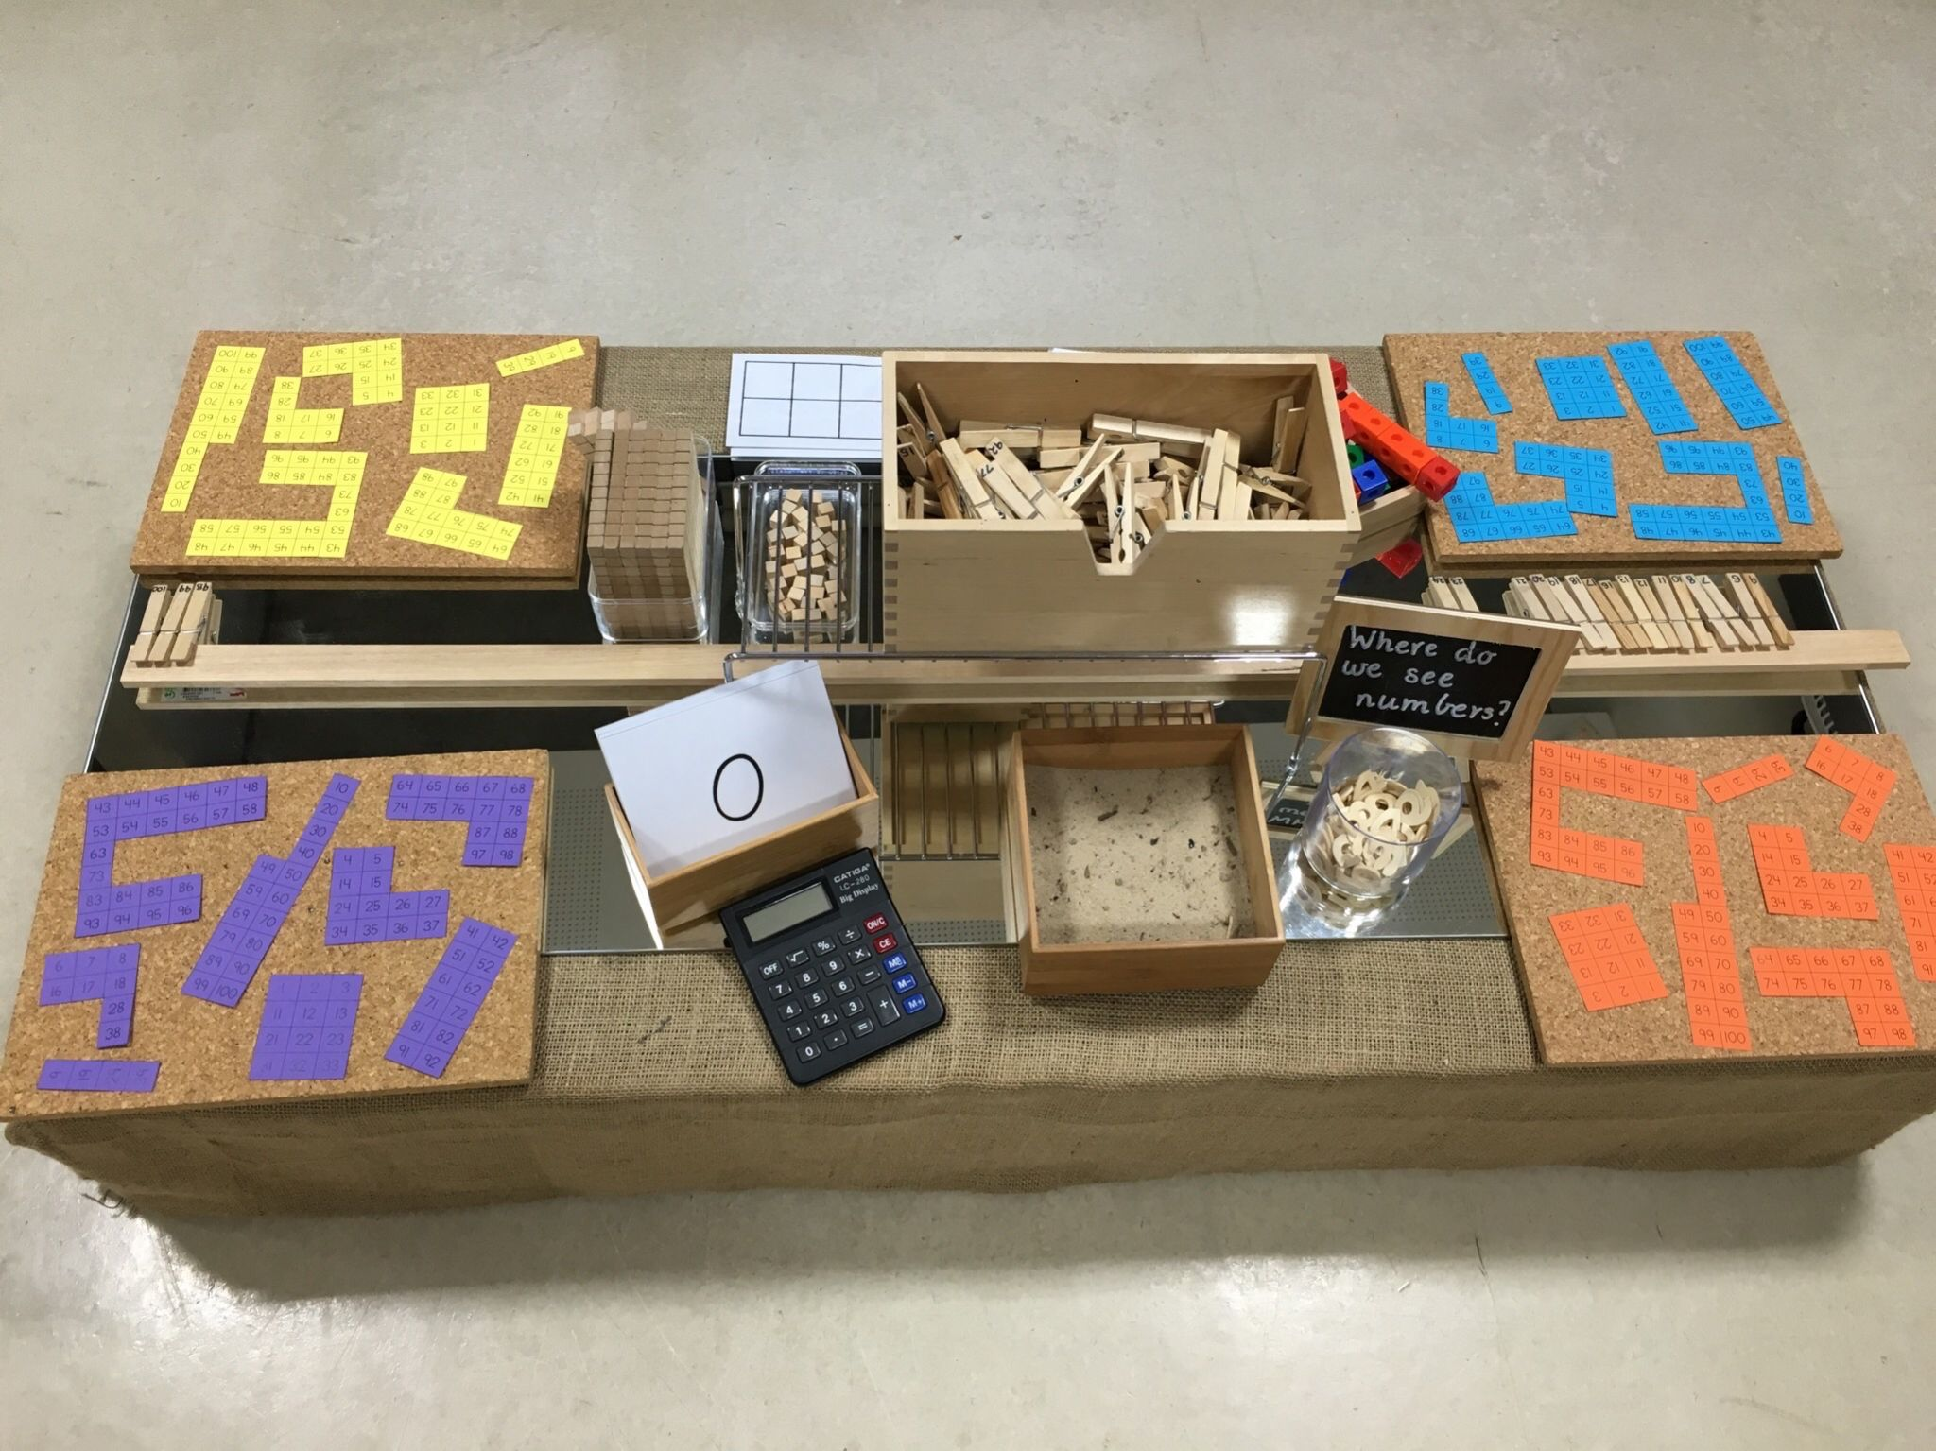
Exploring play spaces
What mathematical concepts could be explored here?
What learning outcomes could be addressed through this explorative play experience?
one to one correspondence, counting sequences, recognising numerals, creating numbers
Establish understanding of the language and processes of counting by naming numbers in sequences, initially to and from 20, moving from any starting point (ACMNA001

Slide 20
Exploring play spaces
What mathematical concepts could be explored here?
What learning outcomes could be addressed through this explorative play experience?
numeral recognition, number quantities, number names
Connect number names, numerals and quantities, including zero, initially up to 10 and then beyond (ACMNA002)

Slide 21
Can you identify the mathematical concepts embedded in this play..
Crown. (2009). Children thinking mathematically: PSRN essential knowledge for early years practioners. Retrieved from http://www.childrens-mathematics.net/childrenthinkingmathematically_psrn
Notes:
Now it’s your turn…
Use the chat box to identify the mathematical concepts being explored.
weight, volume, size, capacity

Slide 22
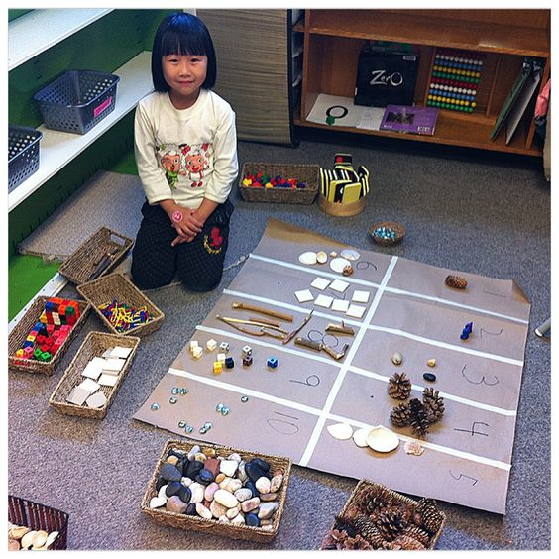
Can you identify the mathematical concepts embedded in this play..
http://thewonderoflearning.blogspot.com/2013/01/counting-beautiful-materials.html
Notes:
sorting, categories, shape properties
number sense - number recognition, quantities, sequencing

Slide 23
Can you identify the mathematical concepts embedded in this play..
Crown. (2009). Children thinking mathematically: PSRN essential knowledge for early years practioners. Retrieved from http://www.childrens-mathematics.net/childrenthinkingmathematically_psrn
Notes:
this one may be a bit tricker…
think about who the children would engage with this play space?
up, down, … movement
over, under, between, on top of.. positional language.

Slide 24
Your turn to plan.
Victorian Curriculum Descriptors Level A - Foundation
A4 White Paper
Notes:
Now it’s your turn to plan some play based learning opportunities
Under the main strands of mathematics populate ideas of play based learning experiences that could be used to address this curriculum content.

Slide 25
Implementing an explorative pedagogical approach to learning -
Notes:
Which leads us to how we as educators can adopt these strategies?
One way we can do this is through an Explorative pedagogical approach to learning through the implementation of a student choice board.
Explain choice board

Slide 26
Questions
Notes:
Thank you!
open up to any questions,
I hope you have enjoyed the session and are able to walk away with some practical examples of possible ways to;
identify and plan for play based maths based experiences into your classrooms.

Slide 27
Get in contact..
Dianne Liddell
dianne@3es.org
www.3es.org

